Slide 1
Linear Regression

Slide 2
What is Linear Regression
The aim of regression analysis is to construct a mathematical model which describes or explain the relationships among variables:
Y (dependent/response/outcome) and
X (independent/explanatory/regressor)
In linear regression, our response variable is continuous
Linear regression is important in various situations e.g.
Forecasting trends (e.g., sales, weather)
Analyzing relationships (e.g., hours studied vs. exam scores).

Slide 3
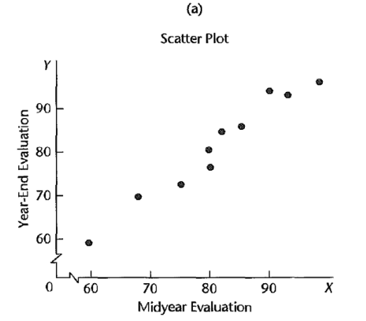
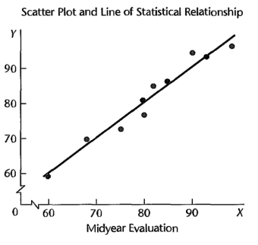
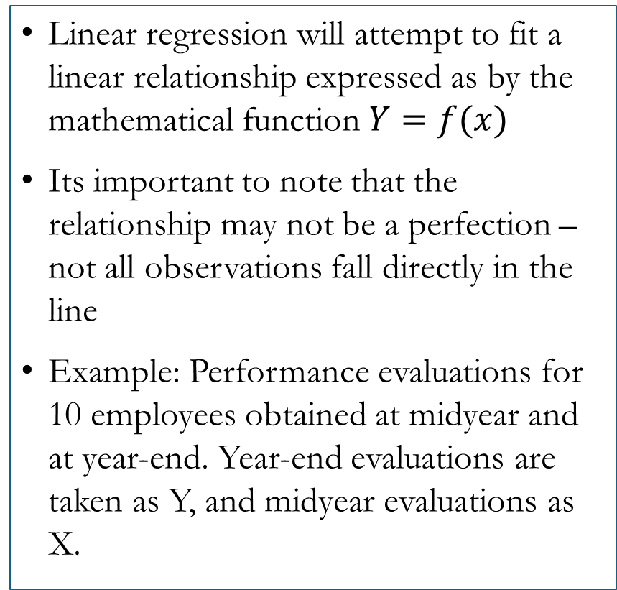
Functional Relationship between Y and X
Linear regression will attempt to fit a linear relationship expressed as by the mathematical function $Y=f(x)$
Its important to note that the relationship may not be a perfection – not all observations fall directly in the line
Example: Performance evaluations for 10 employees obtained at midyear and at year-end. Year-end evaluations are taken as Y, and midyear evaluations as X.
Notes:
Scatter plot
Plot suggests that there is a relation between midyear and year-end evaluations, in the sense that the higher the midyear evaluation, the higher tends to be the year-end evaluation.
The relation is not a perfect one. There is a scattering of points, suggesting that some of the variation in year-end evaluations is not accounted for by midyear performance assessments.
E.g Two employees had midyear evaluations of X = 80, yet they received somewhat different year-end evaluations. Because of the scattering of points in a statistical relation - The plot is called a scatter diagram or scatter plot. In statistical terminology, each point in the scatter diagram represents a trial or a case.
Scatter point with line
Here we have plotted a line of relationship that describes the statistical relation between X and Y. It indicates the general tendency by which Y vary with the
level X
Most of the points do not fall directly on the line of statistical relationship. Scattering of points around the line represents variation in Y that is not associated with X and that is usually considered to be of a random nature.

Slide 4
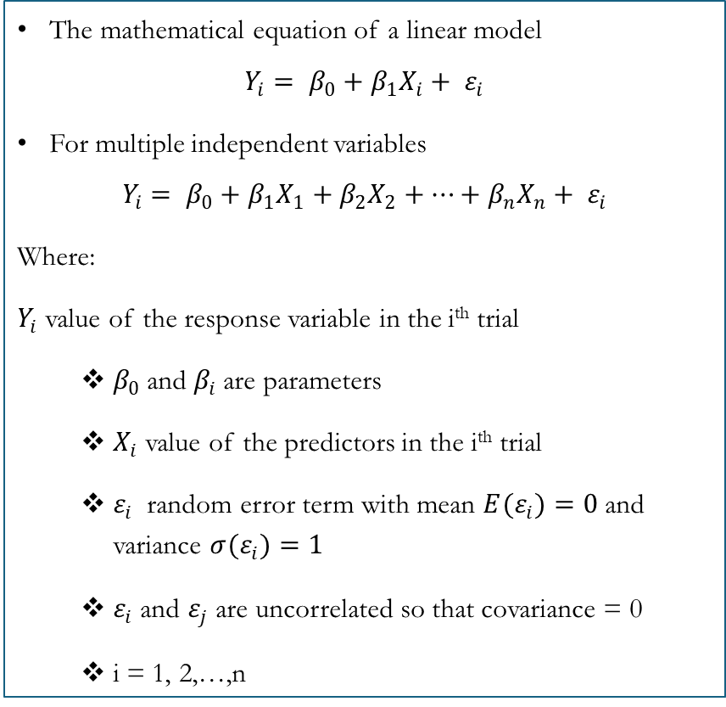
Core Concepts
The mathematical equation of a linear model
$$Y_{i}= β_{0}+β_{1}X_{i}+ ε_{i}$$
For multiple independent variables
$$Y_{i}= β_{0}+β_{1}X_{1}+β_{2}X_{2}+…+β_{n}X_{n}+ ε_{i}$$
Where:
$Y_{i}$ value of the response variable in the i^{th} trial
$β_{0}$and $β_{i}$are parameters
$X_{i}$ value of the predictors in the i^{th} trial
$ε_{i}$ random error term with mean ${E(ε}_{i})=0$ and variance ${σ(ε}_{i})=1$
$ε_{i}$ and $ε_{j}$ are uncorrelated so that covariance = 0
i = 1, 2,…,n
Assumptions of Linear Regression
Linearity: Relationship between X and Y is linear
Independence: Observations are independent
Homoscedasticity: Constant variance of errors
Normal Distribution of Errors
For multiple linear regression there should not be multi-collinearity between the variables
Notes:
where
I Yi value of the response variable in the ith trial
I β0 and β1 are parameters
I Xi value of the predictors in the ith trial
I i random error term with mean Ei = 0 and variance
σ
2
[i
] = σ
2
;i and jare uncorrelated so that covariance=0
I i=1,2...,n

Slide 5
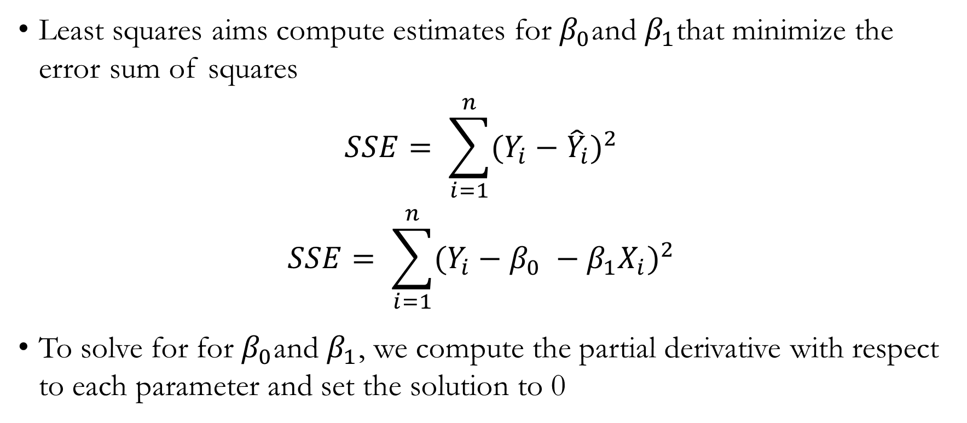
Least Squares Approach to fitting a Linear Regression
Least squares aims compute estimates for $β_{0}$and $β_{1}$that minimize the error sum of squares
$$SSE= \sum_{i=1}^{n}{{(Y_{i}−{\hat{Y}}_{i})}^{2}}$$
$$SSE= \sum_{i=1}^{n}{{(Y_{i}−β_{0} −β_{1}X_{i})}^{2}}$$
To solve for for $β_{0}$and $β_{1}$, we compute the partial derivative with respect to each parameter and set the solution to 0
Notes:
Other approach – maximum likelihood approach
Minimizing puts our estimators close to the true equation
chrome-extension://efaidnbmnnnibpcajpcglclefindmkaj/https://www.amherst.edu/system/files/media/1287/SLR_Leastsquares.pdf

Slide 6

Least Squares Approach to fitting a Linear Regression
Partial derivative with respect to $β_{0}$
$$\frac{δSSE}{δβ_{0}}=\frac{δ}{δβ_{0}}\sum_{i=1}^{n}{{(Y_{i}−β_{0} −β_{1}X_{i})}^{2}}$$
$$nβ_{0}+β_{1}\sum_{i=1}^{n}{X_{i}}=\sum_{i=1}^{n}{Y_{i}}$$
$$0 = \overline{Y}−β_{0}−β_{1}\overline{X}$$
$$β_{0}= \overline{Y}−β_{1}\overline{X}$$

Slide 7
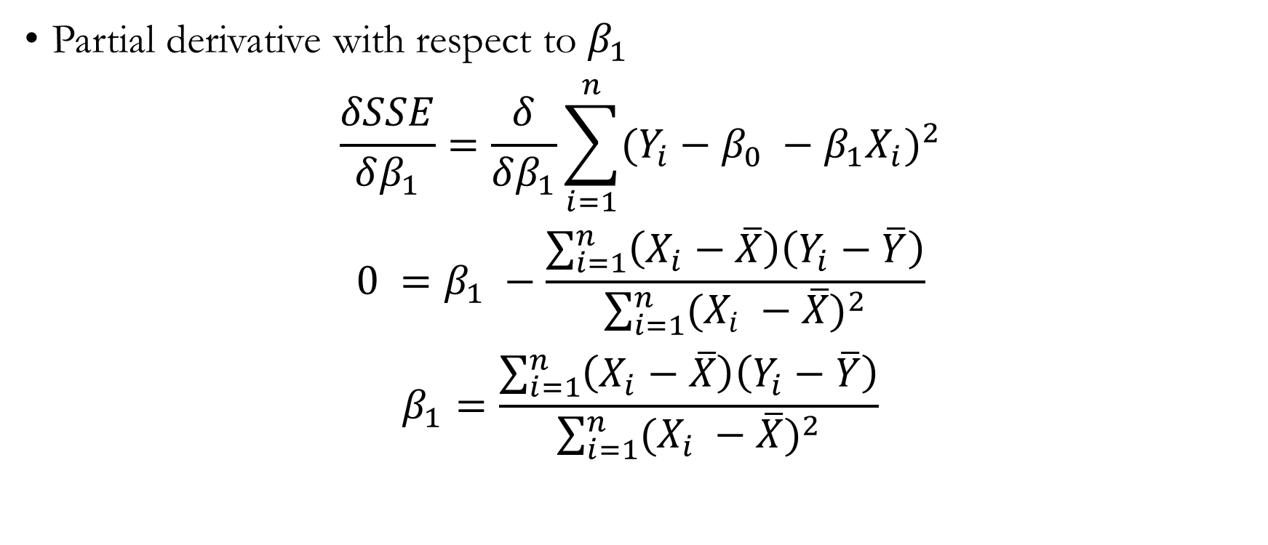
Least Squares Approach to fitting a Linear Regression
Partial derivative with respect to $β_{1}$
$$\frac{δSSE}{δβ_{1}}=\frac{δ}{δβ_{1}}\sum_{i=1}^{n}{{(Y_{i}−β_{0} −β_{1}X_{i})}^{2}}$$
$$0 =β_{1} −\frac{\sum_{i=1}^{n}{\left(X_{i}−\overline{X}\right)\left(Y_{i}−\overline{Y}\right)}}{\sum_{i=1}^{n}{{(X_{i} −\overline{X})}^{2}}}$$
$$β_{1}=\frac{\sum_{i=1}^{n}{\left(X_{i}−\overline{X}\right)\left(Y_{i}−\overline{Y}\right)}}{\sum_{i=1}^{n}{{(X_{i} −\overline{X})}^{2}}}$$
Notes:
Resources attached on the video description

Slide 8
Example – Manual Fitting of a Linear Regression
$$Y=2.542+0.7553X$$

Slide 9
Model Evaluation
R-squared ( R² ): Measures the proportion of variance in the dependent variable explained by the model. Higher values indicate better fit.
Adjusted R-squared: Similar to ( R² ), but adjusts for the number of predictors in the model. Penalizes adding irrelevant variables.
Mean Squared Error (MSE): Average of the squared differences between observed and predicted values. Smaller values imply a better-fitting model.
Root Mean Squared Error (RMSE): The square root of MSE, providing an error metric in the same units as the dependent variable.
Mean Absolute Error (MAE): Average of the absolute differences between observed and predicted values. Less sensitive to outliers than MSE or RMSE.
Akaike Information Criterion (AIC) & Bayesian Information Criterion (BIC): Metrics that penalize model complexity and assess the trade-off between model fit and simplicity.
F-statistic: Evaluates the overall significance of the regression model. It tests whether the model explains a significant portion of the variance in the dependent variable.
Notes:
We shall see them when building the model in R and Python

Slide 10
Diagnostics Plots
Residuals vs Fitted plot
Helps check linearity and homoscedasticity. Patterns or trends in residuals indicate issues with model assumptions
Residuals vs Fitted Plot: Normal Q-Q Plot
Assesses normality of residuals. Deviations from the diagonal line suggest the residuals may not follow a normal distribution.
Scale-Location Plot (or Spread-Location Plot)
Checks homoscedasticity (constant variance of residuals). A flat pattern is ideal; any funnel-shaped pattern indicates heteroscedasticity
Residuals vs Leverage Plot
Identifies influential observations that have a significant impact on the model. Points with high leverage and large residuals are potential outliers.
Notes:
Help to assess the assumptions after building the model and further evaluate the performance

Slide 11
Linear Regression

